Slide 1
MTK HBPoP yield
action monitor
ASEKH
A3 BB10 2000
Pei Chen
November, 2024

Slide 2
1. 主題選定 | 2. 選定理由 | 3. 目前現況 | 4. 原因分析 | 5. 評估與執行 | 6. 效果確認 | 7. 標準化 | 8. 殘留問題
Select purpose.
Extension project from grave disease quality improvement meeting action items.
Low yield detection on weekly.
Automated analysis to identify top defect for improvement.
Customization of dashboard so as not to reduce the output.
Target presentation.
Cut time costs from 3hr to 1 minute.
Notes:
品質沉痾改善會議 、監控、defect

Slide 3
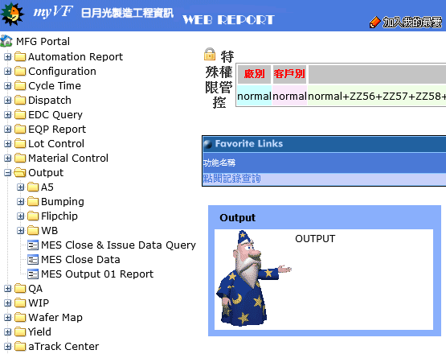
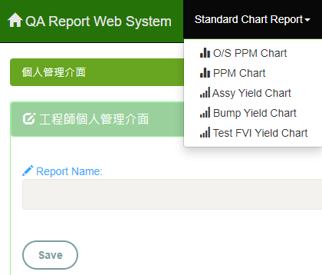
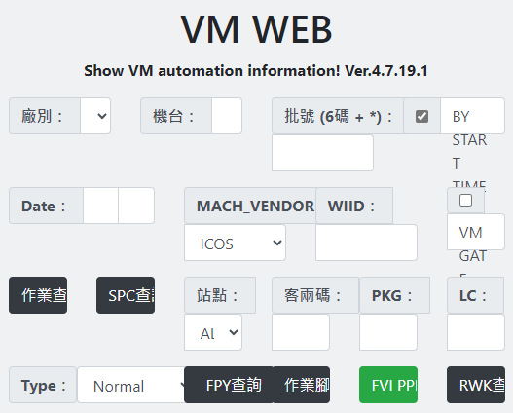
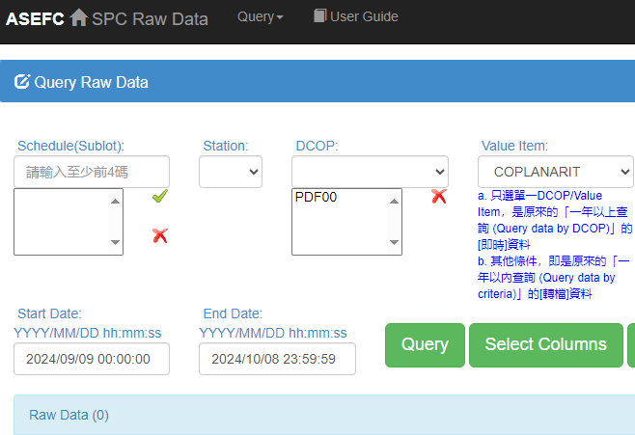
1. 主題選定 | 2. 選定理由 | 3. 目前現況 | 4. 原因分析 | 5. 評估與執行 | 6. 效果確認 | 7. 標準化 | 8. 殘留問題
Current index.
STD KPI
Leading index
Manual current status.
Run time : 3 hour in 16 index / 1 engineer
Raw data download
Data sorting, classification
Exclude special conditions
Copy and paste to the correct area or report
Still have process issues with error
Yield performance
Defect pareto
Close lot list
Overall Yield Performance
(source2)
Daily / weekly chart monitor
BPI mark reject rework rate
BGA rework rate
First Pass Yield
(source3)
Total output
Shift status
By machine chart monitor
Output Status
(source1)
Inline monitor
FCB 3/O LRR
(source4)
TCB SOH monitor
Performance by machine
Molding thickness SOH
Performance by StripMoldChase
Mold Flash
(source4)
source1 : WEB REPORT
source2 : QA REPORT
source3 : VM WEB
source4 : DCOP
Bump bridge
Bump height
Substrate space
(source4)

Slide 4
1. 主題選定 | 2. 選定理由 | 3. 目前現況 | 4. 原因分析 | 5. 評估與執行 | 6. 效果確認 | 7. 標準化 | 8. 殘留問題
Man
Machine
Classify device not enough
Miss operation
Paste wrong location
Engineers reduce the output
by a weekly round
Inflexible excel formula
Processing data inefficiently
Method
Material
4

Slide 5
1. 主題選定 | 2. 選定理由 | 3. 目前現況 | 4. 原因分析 | 5. 評估與執行 | 6. 效果確認 | 7. 標準化 | 8. 殘留問題
Compare requirements to database
Programming by engineer logic
Data Studio present automation
Source
1-4
data upload
Database
>
automated updates
mapping
Summary
Dashboard
Logic
>

Slide 6
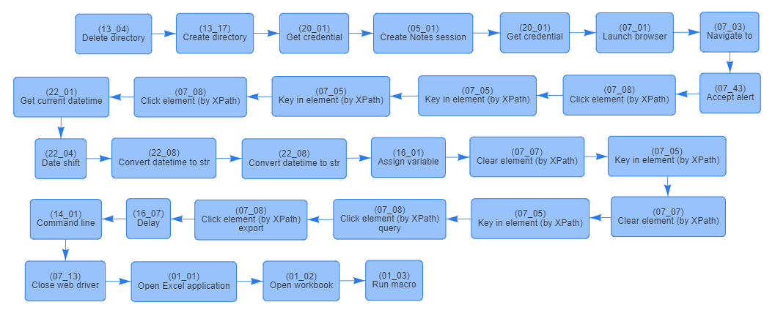
1. 主題選定 | 2. 選定理由 | 3. 目前現況 | 4. 原因分析 | 5. 評估與執行 | 6. 效果確認 | 7. 標準化 | 8. 殘留問題
Raw data pre-processing and confirmation.
When source in database(EDA)
Existing data in ParentLot / SubLot / DCOP / IQA
Mapping device 24L in SQL
When source in NAS run by RPA
Turn First Pass Yield / Bump bridge data into csv
Create SR to server
Representative index
Representative index
Raw data (xlsm)
Yield performance
Defect pareto
Close lot list
Total output
Shift status
By machine chart monitor
FCB 3/O LRR
TCB SOH monitor
Performance by machine
Molding thickness SOH
Performance by StripMoldChase
Daily / weekly chart monitor
BPI mark reject rework rate
BGA rework rate
Bump height
Substrate space
Run macro
Keep necessary column
Paste raw data to sheet
Convert to csv
Scheduled start RPA
Daily update

Slide 7
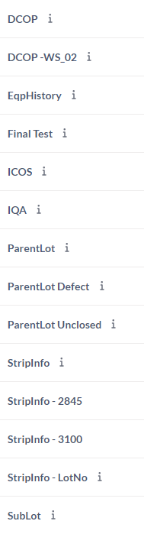
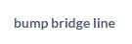
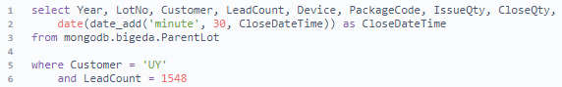
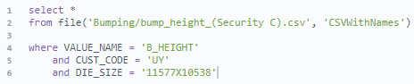
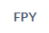
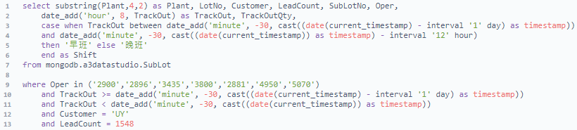
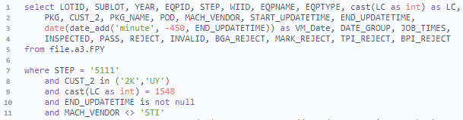
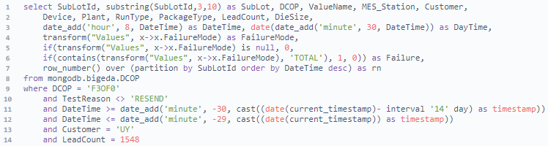
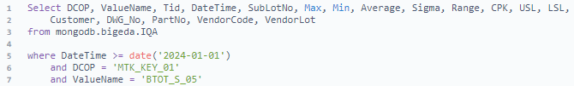
1. 主題選定 | 2. 選定理由 | 3. 目前現況 | 4. 原因分析 | 5. 評估與執行 | 6. 效果確認 | 7. 標準化 | 8. 殘留問題
Data programming and mapping.
First step.
Corresponding correct information
Customer : UY
Leadcount : 1548
EDA representative index
NAS representative index
Yield performance
Defect pareto
Close lot list
Total output
Shift status
By machine chart monitor
FCB 3/O LRR
TCB SOH monitor
Performance by machine
Molding thickness SOH
Performance by StripMoldChase
Daily / weekly chart monitor
BPI mark reject rework rate
BGA rework rate
Bump height
Substrate space

Slide 8
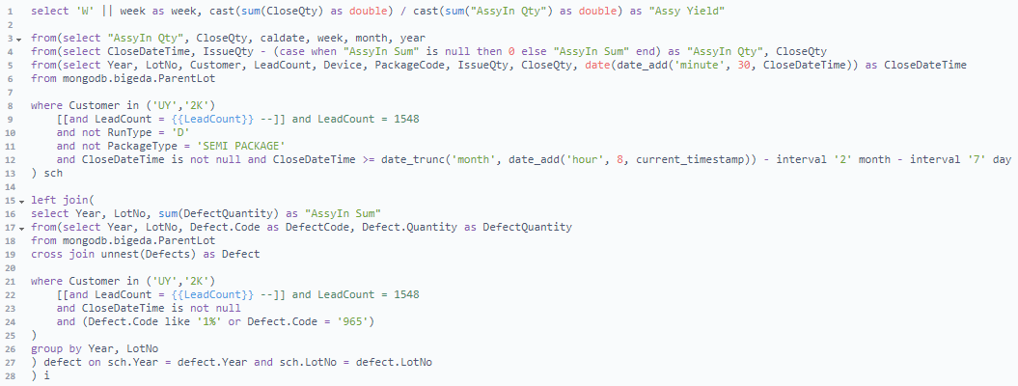
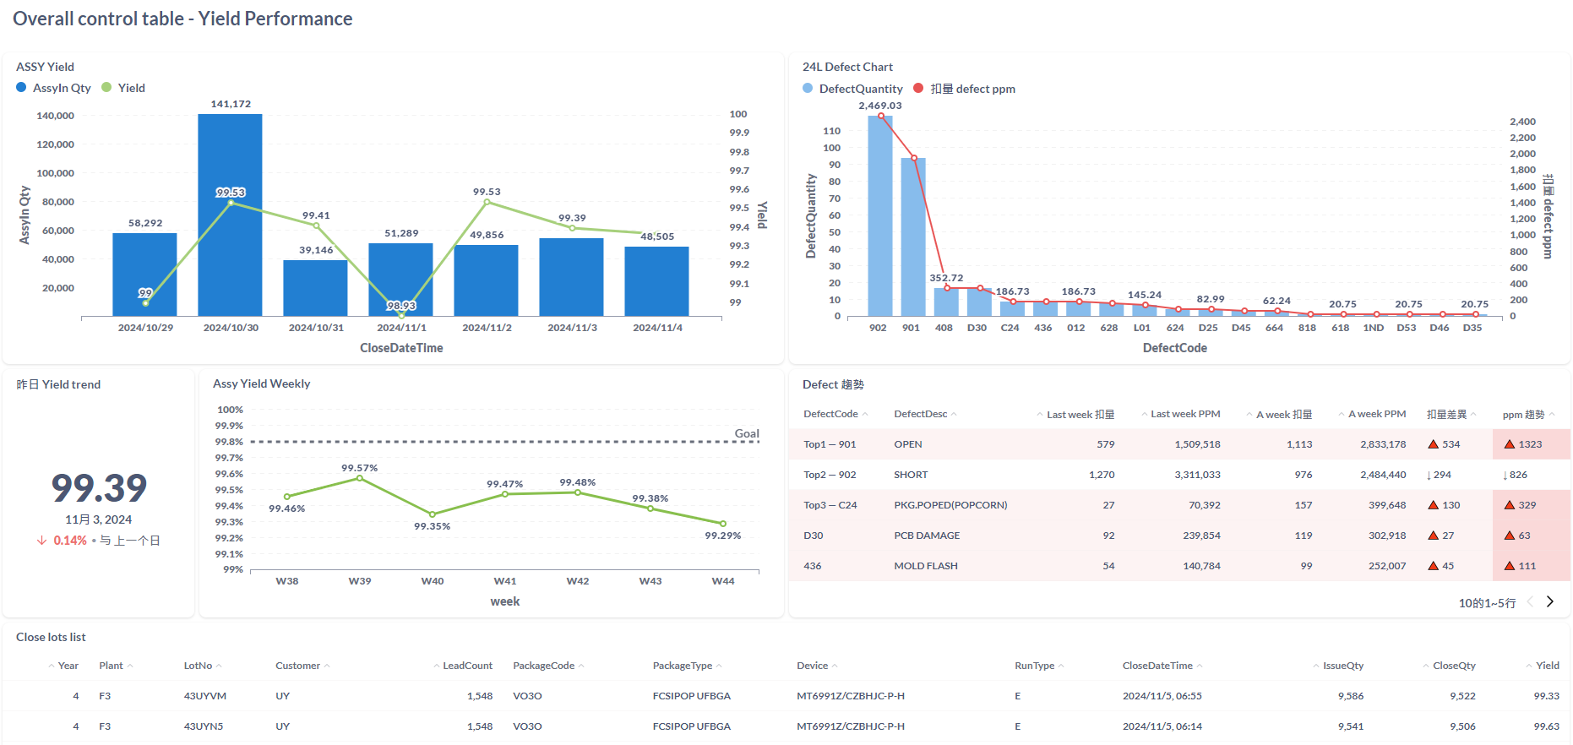
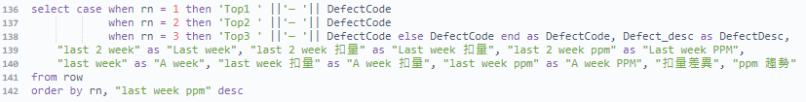
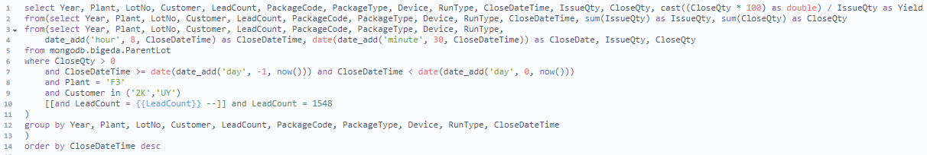
1. 主題選定 | 2. 選定理由 | 3. 目前現況 | 4. 原因分析 | 5. 評估與執行 | 6. 效果確認 | 7. 標準化 | 8. 殘留問題
Data programming and mapping.
Second action phase 1.
Calculate and present according to conditions
A day / weekly Assy yield and closeqty monitor
Defect compare distribution
Close lots schedule list summary
EDA representative index
Result
Yield performance -- 1
Defect pareto --2
Close lot list --3
Total output
Shift status
By machine chart monitor
FCB 3/O LRR
TCB SOH monitor
Performance by machine
Molding thickness SOH
Performance by StripMoldChase
-- 1
Fetch time interval (yesterday and weekly)
Condition filter exclusion
Sum the quantity
Come to Yield conclusion
-- 2
Quantity calculate independently
Join all field
Unify types into varchar
Sequencing and rename
-- 3
Select key information

Slide 9
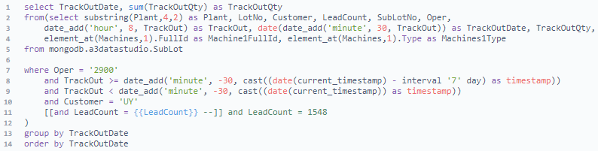
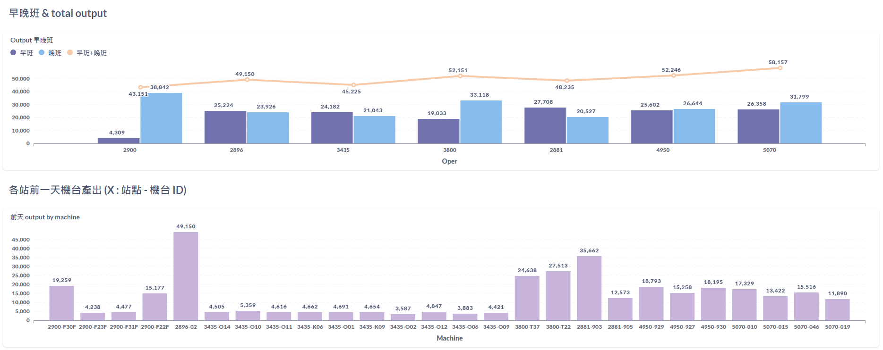
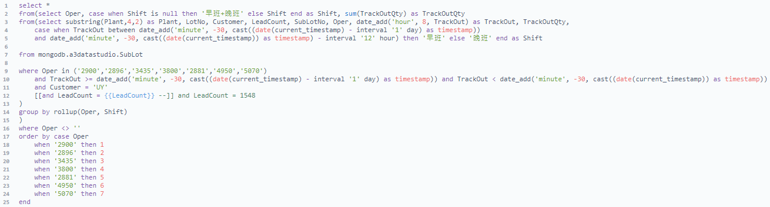
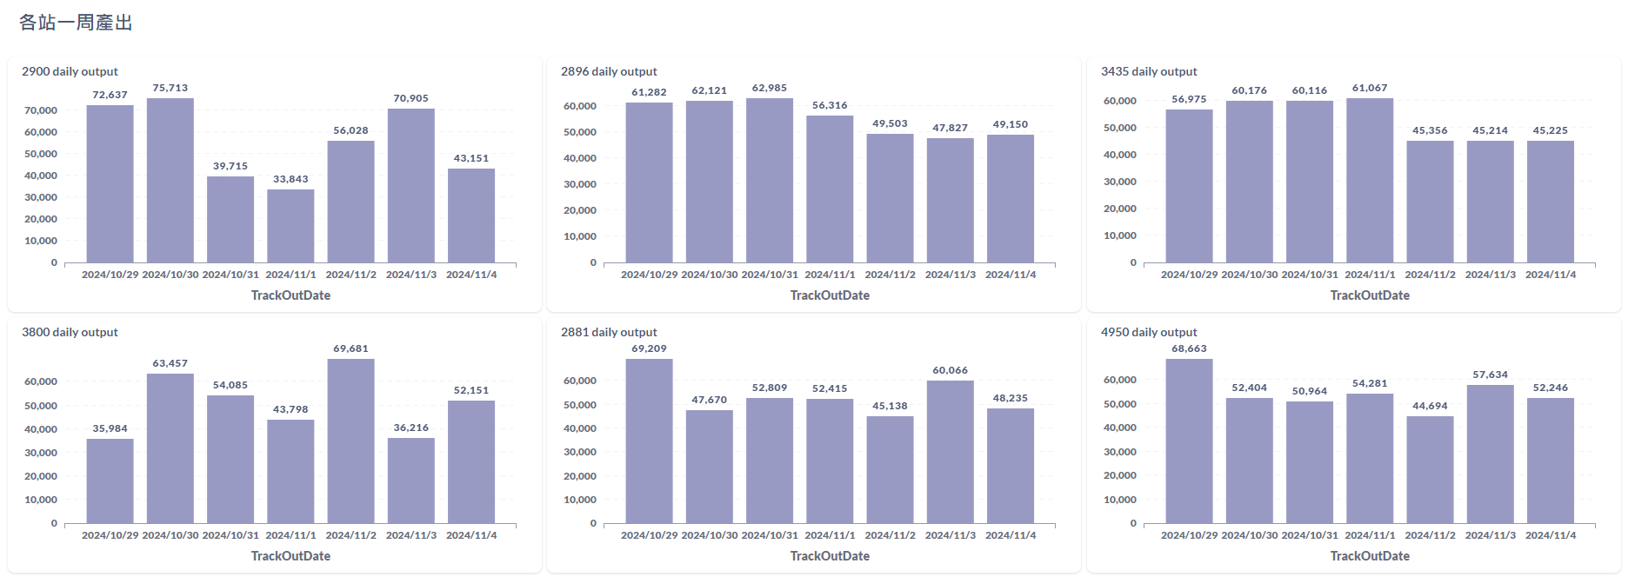
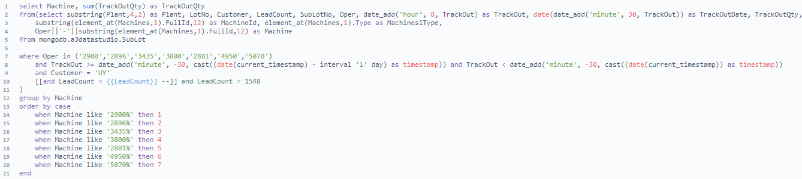
1. 主題選定 | 2. 選定理由 | 3. 目前現況 | 4. 原因分析 | 5. 評估與執行 | 6. 效果確認 | 7. 標準化 | 8. 殘留問題
Data programming and mapping.
Second action phase 2.
Calculate and present according to conditions
A day / daily output monitor
Machine status
EDA representative index
Result
Yield performance
Defect pareto
Close lot list
Total output -- 4
Shift status -- 5
By machine chart monitor -- 6
FCB 3/O LRR
TCB SOH monitor
Performance by machine
Molding thickness SOH
Performance by StripMoldChase
-- 4
The time interval setting
Sum the quantity
-- 5
Same as 4
Order by case oper
-- 6
Turn machine field name
Order by case machine

Slide 10
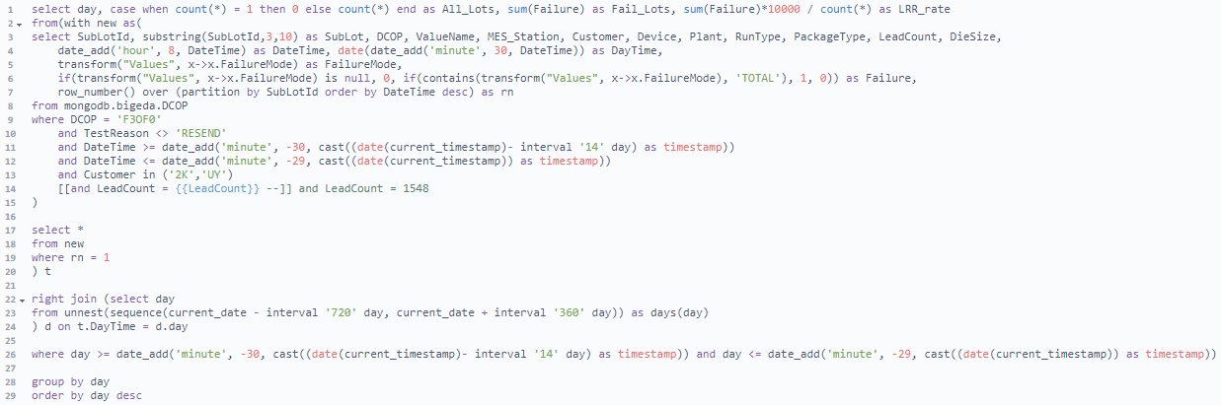
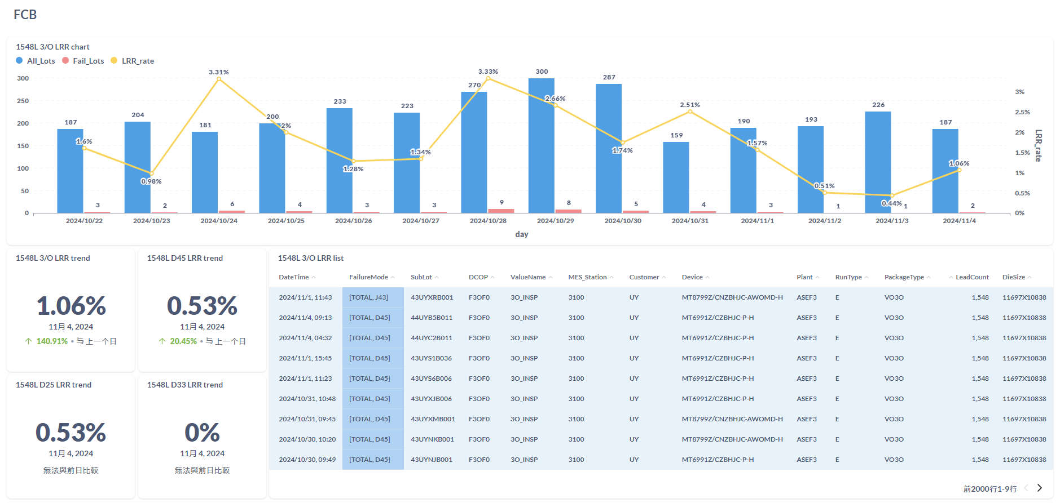
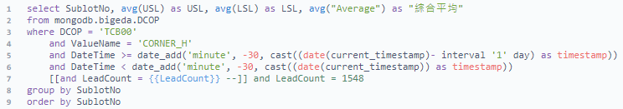
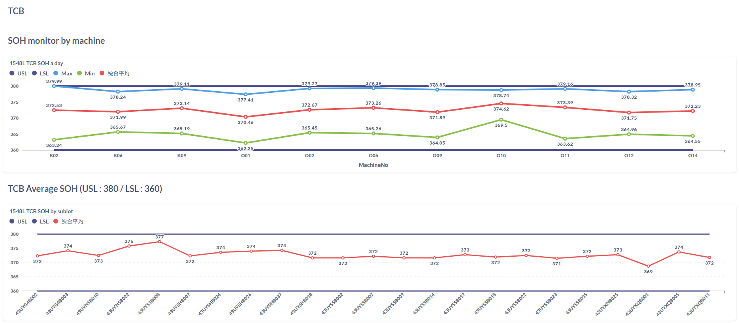
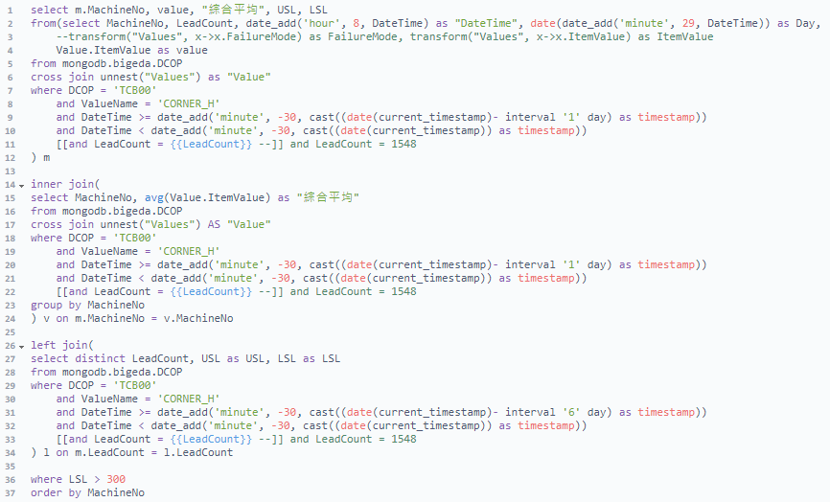
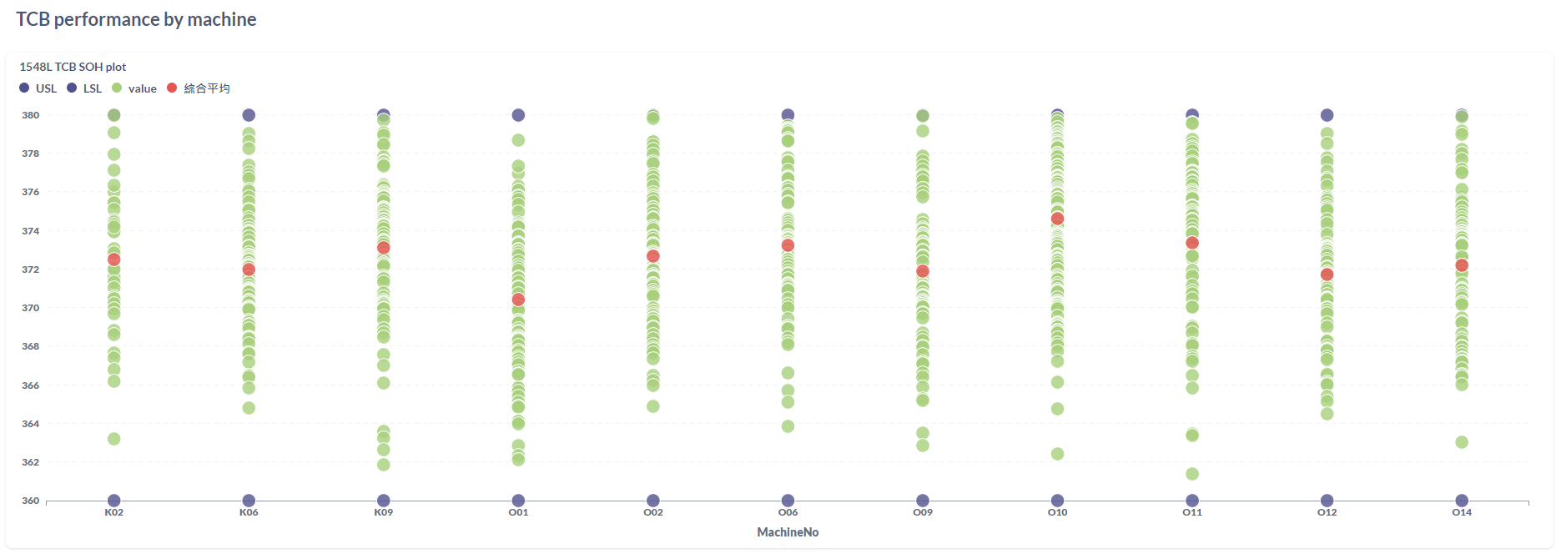
1. 主題選定 | 2. 選定理由 | 3. 目前現況 | 4. 原因分析 | 5. 評估與執行 | 6. 效果確認 | 7. 標準化 | 8. 殘留問題
Data programming and mapping.
Second action phase 3.
Calculate and present according to conditions
SOH control demarcation line monitor
According to different X-axis factors
EDA representative index
Result
Yield performance
Defect pareto
Close lot list
Total output
Shift status
By machine chart monitor
FCB 3/O LRR -- 7
TCB SOH monitor -- 8
Performance by machine -- 9
Molding thickness SOH -- 10
Performance by StripMoldChase -- 11
-- 7
The time interval setting
Exclude resend data
Keep the latest sublot information
Defect contain specific failuremode
-- 8 / 10
Average value present in line
-- 9 / 11
Present the value of each point
Exclude data less than LSL
Order by case machine
Order by case tooling

Slide 11
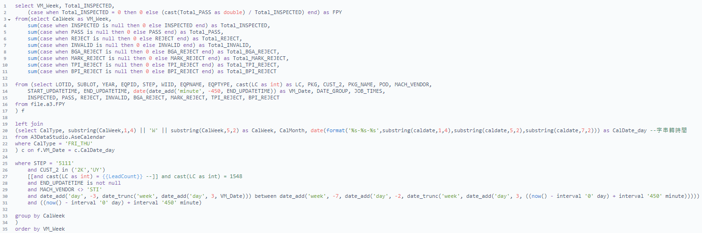
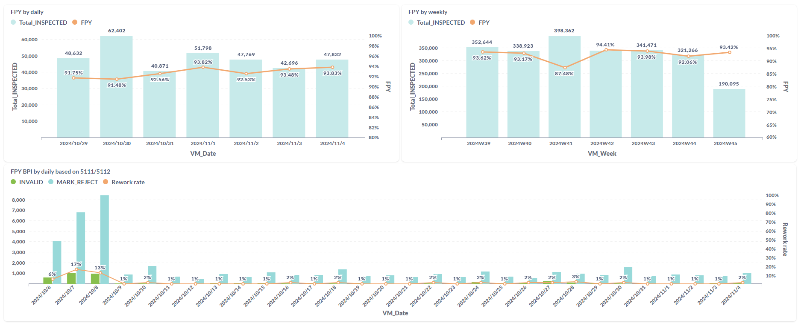
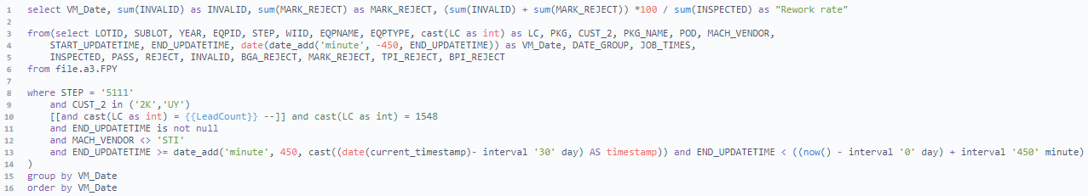
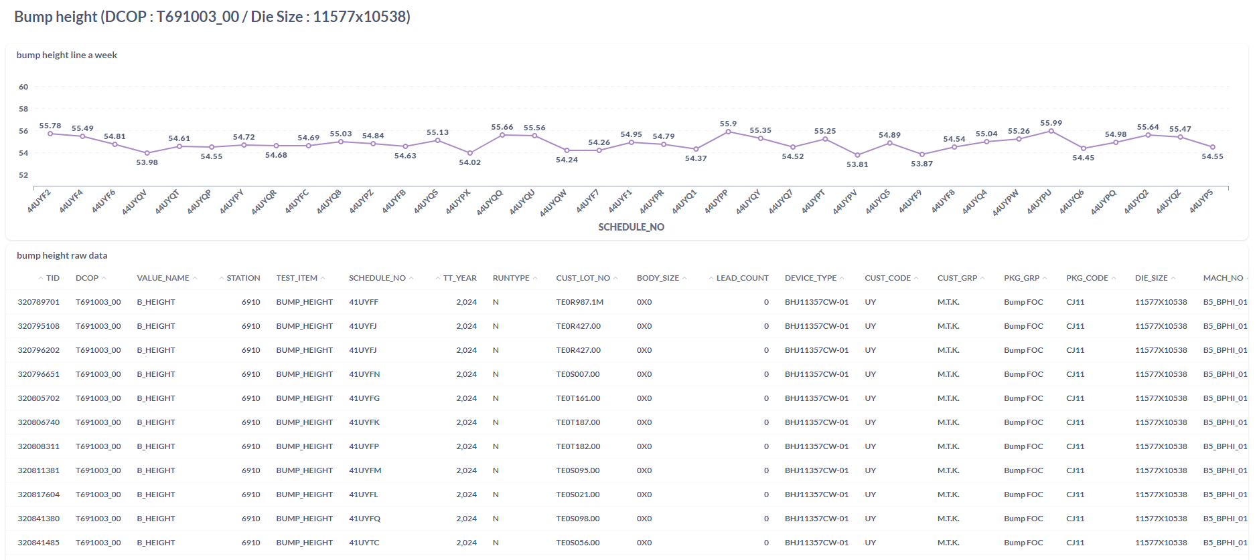
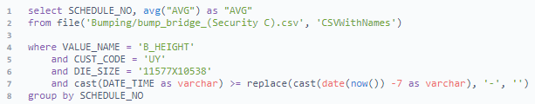
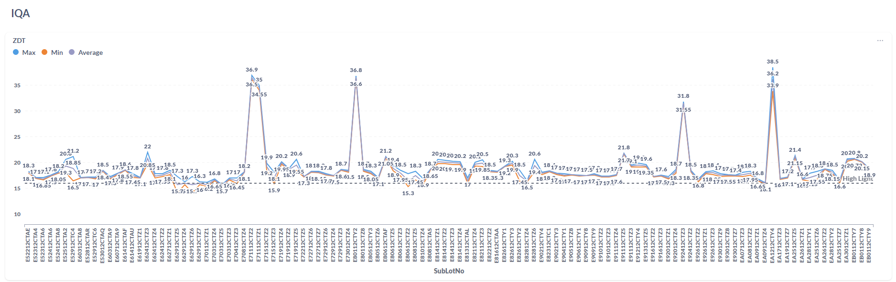
1. 主題選定 | 2. 選定理由 | 3. 目前現況 | 4. 原因分析 | 5. 評估與執行 | 6. 效果確認 | 7. 標準化 | 8. 殘留問題
Data programming and mapping.
Third part.
Calculate and present according to conditions
Confirm macro is in run
Inline monitor and material control
Present value status
NAS representative index
Result
Daily / weekly chart monitor -- 1
BPI mark reject rework rate -- 2
BGA rework rate -- 3
Bump height -- 4
Substrate space -- 5
-- 1
Fetch time interval (daily and weekly)
Condition filter exclusion
Quantity calculate independently
Come to Yield conclusion
-- 2 / 3
Classify reject items
-- 4 / 5
Filter structure
Average value present in line

Slide 12
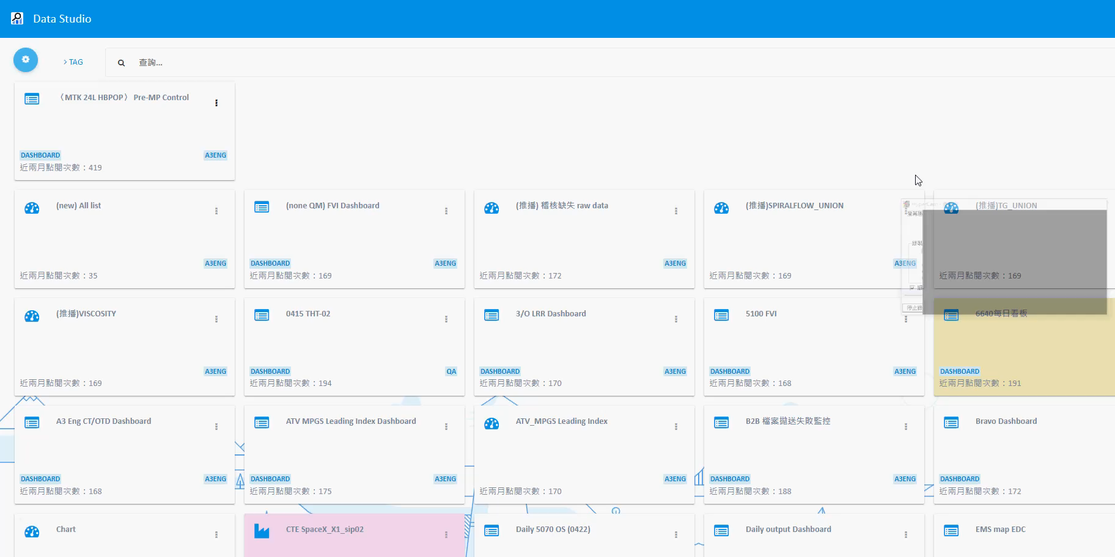
1. 主題選定 | 2. 選定理由 | 3. 目前現況 | 4. 原因分析 | 5. 評估與執行 | 6. 效果確認 | 7. 標準化 | 8. 殘留問題
Condition | AS IS | TO BE
MTK MP Dashboard | Manual | RPA and Data Studio
Cost | 3 hour (16 index) | Less than 1 min
Target confirmed : <1 min, meet goal

Slide 13
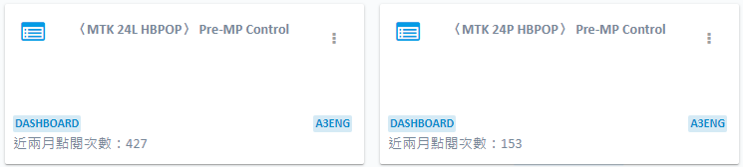
1. 主題選定 | 2. 選定理由 | 3. 目前現況 | 4. 原因分析 | 5. 評估與執行 | 6. 效果確認 | 7. 標準化 | 8. 殘留問題
Standardization.
Dashboard link roll out to engineers
It could adjust variables and turn into other product value
Login permissions
Adjust variables
Confirm each data
Choose presentation method

Slide 14
1. 主題選定 | 2. 選定理由 | 3. 目前現況 | 4. 原因分析 | 5. 評估與執行 | 6. 效果確認 | 7. 標準化 | 8. 殘留問題
Remain Issue.
Unable to automatically detect new product additions need engineers manual maintenance.
Repeated criteria require correction by personnel to successfully execute the program.

Slide 15
Thank You
www.aseglobal.com

